Slide 1
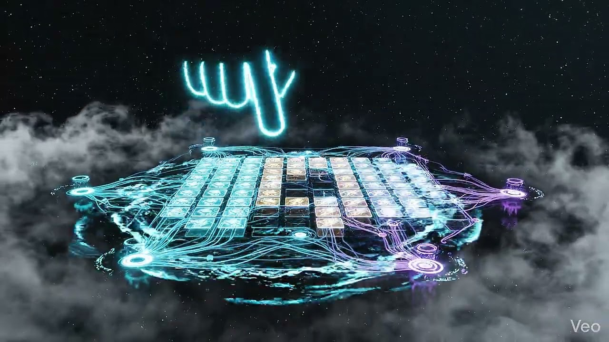
Quantum Minesweeper: Safe Routes
Oļģerts Osipovs

Slide 2
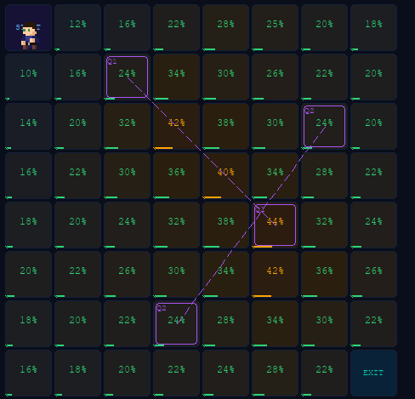
Idea/Gameplay
Main idea:
Decision-making under uncertainty
Evacuation scenario
Limited information
Gameplay:
Start → Exit
SCAN vs STEP
Resources: Public Trust, Scans, Civilian Casualties

Slide 3
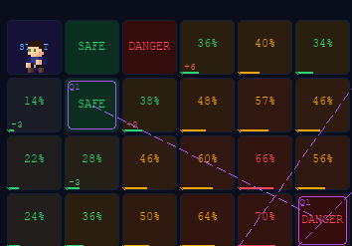
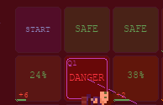
Quantum Concept
Probability instead of fixed state
Collapse on interaction
System changes when observed

Slide 4
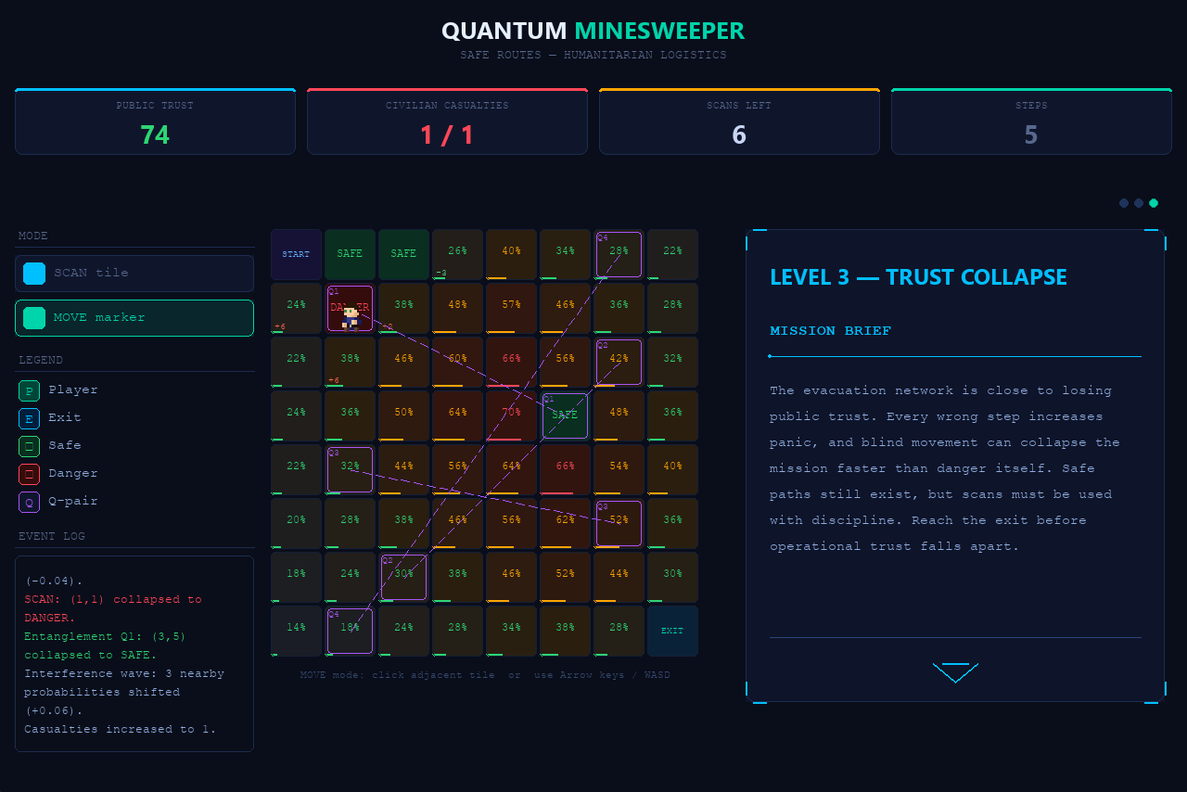
Social Good
Evacuation context
Public Trust
Civilian casualties
Cost of information

Slide 5
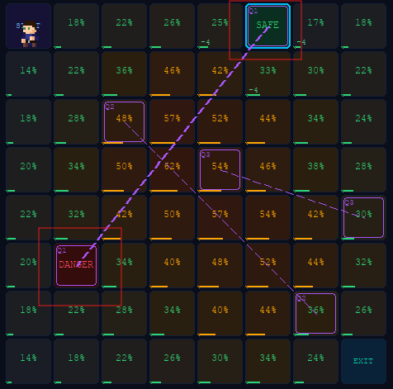
Entanglement & Interference
Q-pairs
Linked outcomes
Probability shifts

Slide 6
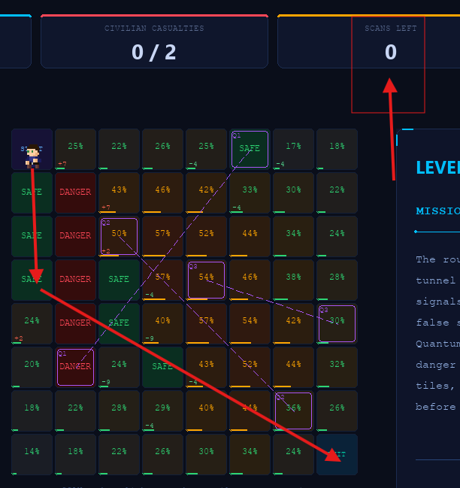
Gameplay Strategy
Don’t scan everything
Balance risk and knowledge
Plan ahead

Slide 7
LET’S TRY IT OUT

